Slide 1
Windows Tech Series Windows 10 Enterprise E3 in CSP Management
Speaker 1
Title
Speaker 2
Title

Slide 2
Agenda
Day | Day 1 Deployment | Day 2 Management | Day 3 Security | Day 4 Windows for CSP
 |  |  |  | Deployment | Management | Security
Synopsis | Module 1 – Introduction | Module 1 – Base System Setup | Module 1 – Analysis Of Common Threats | Module 1 – Subscription
 | Module 2 – Applications & Updates | Module 2 – Configuration | Module 2 – Hardening Windows | Module 2 – Deployment
 | Module 3 – Windows as a Service (WaaS) | Module 3 – Managing Client Devices | Module 3 – Advanced Threat Protection | Module 3 – Management
 | Module 4 – Browsers & Internet Security | Module 4 – Advanced management options I | Module 4 – Information Security (WIP/AIP) | Module 4 – Security
 | Module 5 – Secure Boot & Device Guard | Module 5 - Advanced management options II | Module 5 – Internet Security

Slide 3

MDM in Windows 10

Slide 4
Enrollment options to Microsoft Intune:
Connect to work or school
Join Azure AD
OOBE experience

Slide 5
Azure AD Join
MDM
User can login to their device with Azure AD credentials
Set local administrators
Staff can be blocked from logging on to the device
10
MDM enrollment of device can be enforced
SSO to Office 365 & SaaS Apps

Slide 6
Intune Enrollment
Intune
Apply Policy Settings to the device
Store App deployment to the device
10
Report on the Health of the device against compliance Policies
Remote Wipe capabilities

Slide 7
OneDrive
Office 365
Azure
Intune
Dynamics

Slide 8
Azure AD Join under the hood

Slide 9
Azure
Device Registration
Service
Microsoft Azure
Active Directory
Intune
10

Slide 10
Azure
Device Registration
Service
Microsoft Azure
Active Directory
Azure AD username and Password (+ MFA if enabled)
Intune
10

Slide 11
Azure
Device Registration
Service
Microsoft Azure
Active Directory
Azure AD returns ADRS SSO Token, Local admin accounts and MDM URL’s
Intune
10

Slide 12
Azure
Device Registration
Service
Microsoft Azure
Active Directory
Win 10 then performs a device registration against ADRS using token provided by Azure AD
Intune
10

Slide 13
ADRS writes a device object to Azure AD
Azure
Device Registration
Service
Microsoft Azure
Active Directory
Intune
10

Slide 14
Azure
Device Registration
Service
Microsoft Azure
Active Directory
ADRS issues a device registration certificate to the client
Intune
10

Slide 15
Azure
Device Registration
Service
Microsoft Azure
Active Directory
MDM URL’s passed to MDM Enrollment Agent
Intune
10

Slide 16
Azure
Device Registration
Service
Microsoft Azure
Active Directory
MDM Agent connects to Azure AD for SSO token to access MDM application
Intune
10

Slide 17
Azure
Device Registration
Service
Microsoft Azure
Active Directory
Azure AD returns MDM SSO Token
Intune
10

Slide 18
Azure
Device Registration
Service
Microsoft Azure
Active Directory
Intune
10
MDM Agent uses SSO Token to start MDM enrollment

Slide 19
Azure
Device Registration
Service
Microsoft Azure
Active Directory
Intune
10
MDM enrolls device and pushes down policy to Windows 10

Slide 20
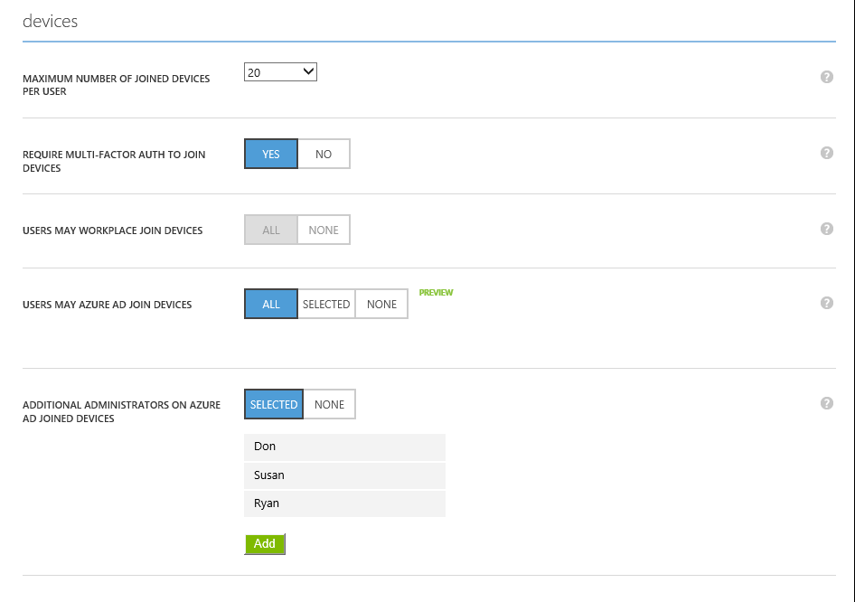

Slide 21
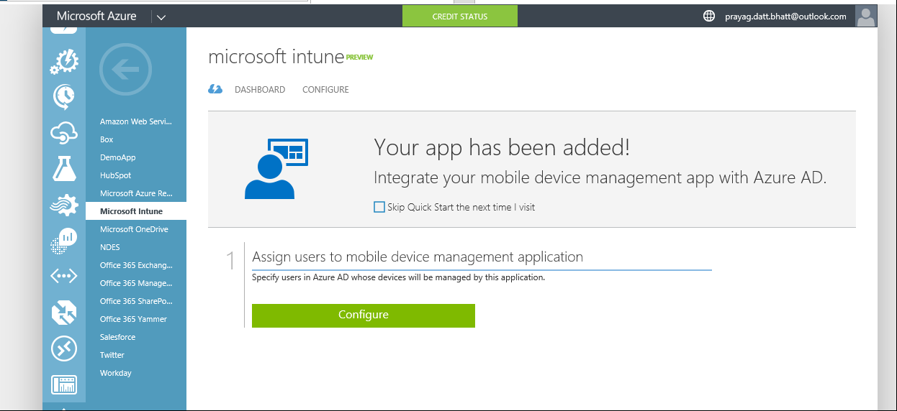

Slide 22
SSO in Hybrid Setup

Slide 23
Microsoft Azure
Active Directory
OneDrive
Office 365
Intune
Dynamics
Azure AD
Connect
SCCM Intune
Hybrid Connection
Windows Server
Active Directory
System Center Configuration Manager

Slide 24
Microsoft Azure
Active Directory
OneDrive
Office 365
Intune
Dynamics
Primary
Refresh
Token
Username
Password
PRT
Username
Password
TGT
Kerberos Ticket
Windows Server
Active Directory
System Center Configuration Manager

Slide 25
Microsoft Azure
Active Directory
OneDrive
Office 365
Intune
Dynamics
SSO Token
Kerberos Ticket
PRT
TGT
Windows Server
Active Directory
System Center Configuration Manager

Slide 26
OMA-DM

Slide 27




Windows 10 Mobile Management Architecture
MDM (Intune)
Provisioning
EAS
ConfigMgr
Service/Server
Device/OS
MDM Client
Provisioning Engine
EAS Client
WMI Bridge
Common Device Configurator
WMI providers
MDM Configuration Service Providers (CSP’s)
Common component
PC component
Notes:
So what is special about the MDM components in Windows 10 that makes this possible?
Looking a bit under the hood, the MDM stack is designed in such a way that whatever management tool you use in your Enterprise to set policies - for eg. Microsoft IT sets policies through MDM and also Exchange Active Sync – they all go through the same management layer <click> thus making automatic configuration resolution possible by the device.
<click>
System Center configuration manager is a popular tool and is widely used by many Enterprises including our own IT. We understand that you may not migrate immediately to MDM & so built a layer in the MDM platform that helps bridge WMI that System Center configuration manager uses to the capabilities that MDM provides
So what are the new features that Windows 10 MDM provides. For this, I want to rewind 8 months. Microsoft gave me a brand new laptop and a phone to install windows 10 builds on for testing and providing feedback. The first thing that I did when I got these devices was to connect to Microsoft Wifi, but it wouldn’t connect. I was only able to connect to the open Wifi network that gave me internet access. I realized that Microsoft IT wanted me to first enroll the device in MDM before I can connect to corporate Wifi. <click>
3

Slide 28

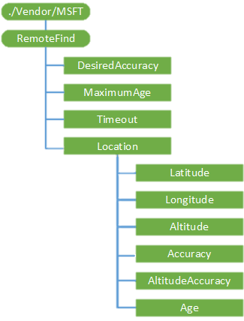

Windows 10 – OMA-DM Communication
Configuration Service Provider
A CSP is an interface to read, set, modify, or delete configuration settings on the device
SyncML
File with all information to configure CSP
SyncML
MDM Client
Common Device Configurator
MDM Configuration Service Providers (CSP’s)
MDM (Intune)

Slide 29
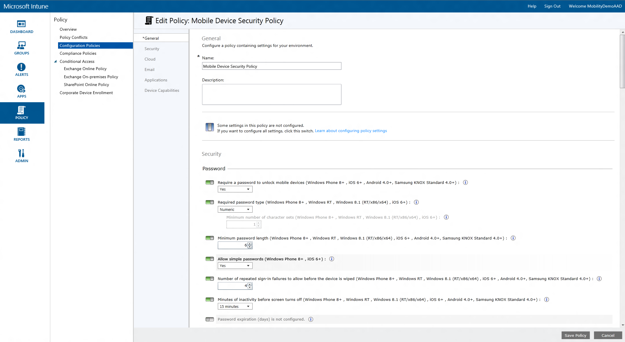
Sample Policy in Intune MinDevicePasswordLength CSP

Slide 30
Sample SyncML - MinDevicePasswordLength
<SyncML xmlns='SYNCML:SYNCML1.2'>
<SyncHdr>
<VerDTD>1.2</VerDTD>
<VerProto>DM/1.2</VerProto>
<SessionID>1</SessionID>
<MsgID>1</MsgID>
<Target>
<LocURI>{unique device ID}</LocURI>
</Target>
<Source>
<LocURI>https://www.contoso.com/mgmt-server</LocURI>
</Source>
</SyncHdr>
<SyncBody>
<!-- update device setting -->
<Replace>
<CmdID>2</CmdID>
<Item>
<Target>
<LocURI>./Vendor/MSFT/Policy/Config/DeviceLock/MinDevicePasswordLength</LocURI>
</Target>
<Meta>
<Type xmlns="syncml:metinf">text/plain</Type>
<Format xmlns="syncml:metinf">int</Format>
</Meta>
<Data>6</Data>
</Item>
</Replace>
<Final />
</SyncBody>
</SyncML>
Device
SyncHeader
OMA-URI
Open Mobile Alliance - Uniform Resource Uniform Resource Identifier
SyncML
SyncBody
Value

Slide 31
OMA-URI

Slide 32
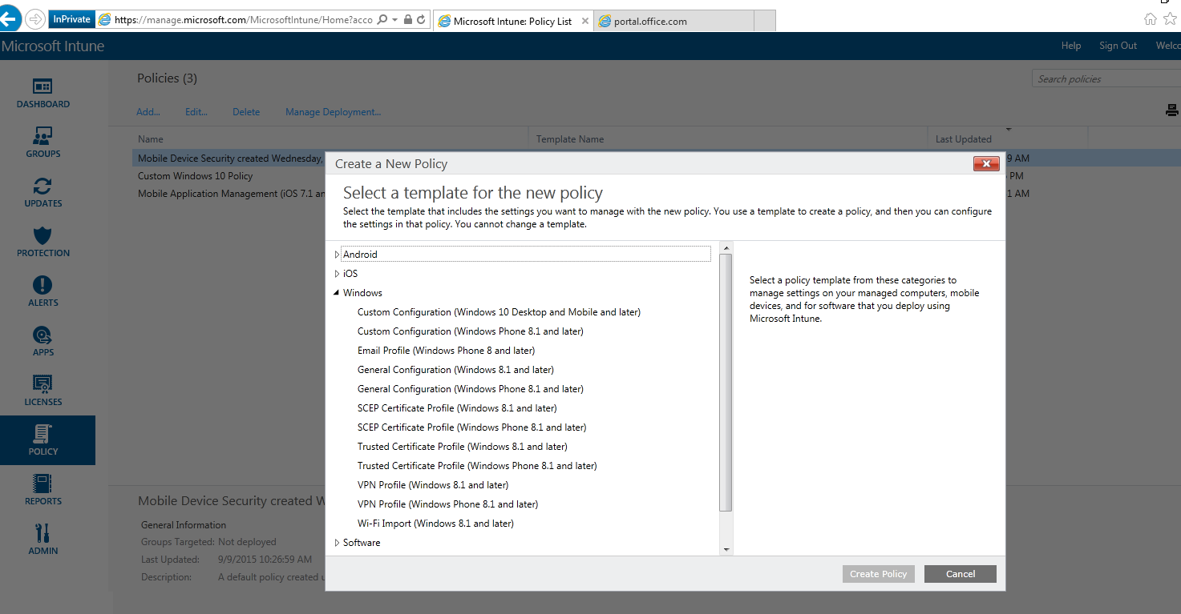
Notes:
So what is special about the MDM components in Windows 10 that makes this possible?
Looking a bit under the hood, the MDM stack is designed in such a way that whatever management tool you use in your Enterprise to set policies - for eg. Microsoft IT sets policies through MDM and also Exchange Active Sync – they all go through the same management layer <click> thus making automatic configuration resolution possible by the device.
<click>
System Center configuration manager is a popular tool and is widely used by many Enterprises including our own IT. We understand that you may not migrate immediately to MDM & so built a layer in the MDM platform that helps bridge WMI that System Center configuration manager uses to the capabilities that MDM provides
So what are the new features that Windows 10 MDM provides. For this, I want to rewind 8 months. Microsoft gave me a brand new laptop and a phone to install windows 10 builds on for testing and providing feedback. The first thing that I did when I got these devices was to connect to Microsoft Wifi, but it wouldn’t connect. I was only able to connect to the open Wifi network that gave me internet access. I realized that Microsoft IT wanted me to first enroll the device in MDM before I can connect to corporate Wifi. <click>
3

Slide 33
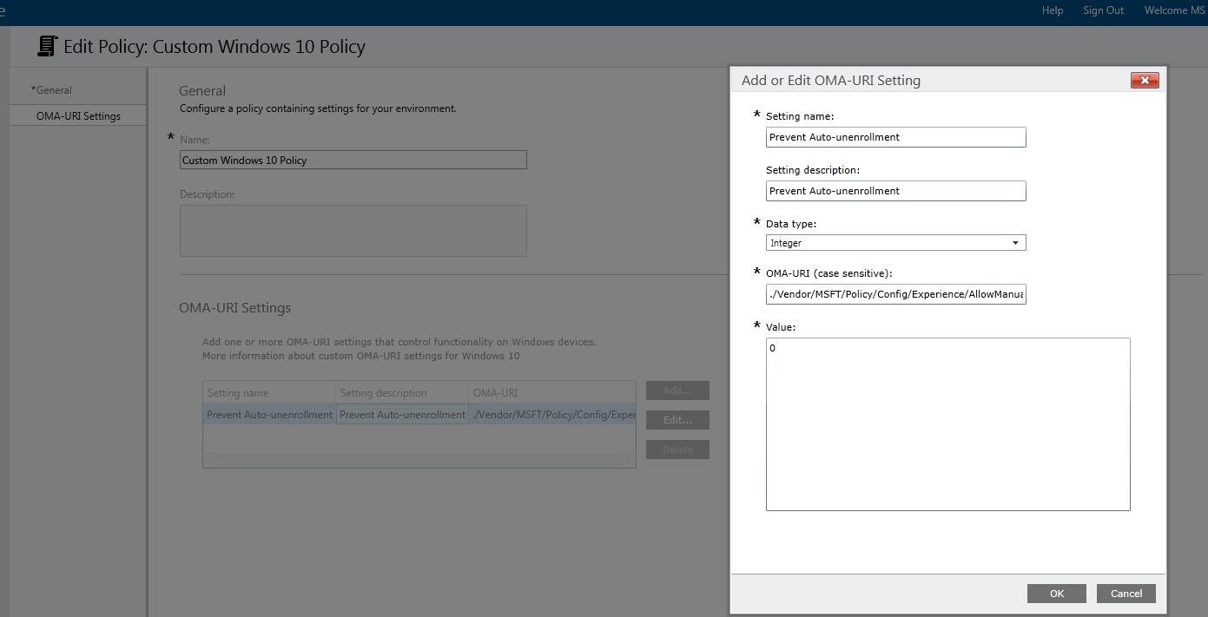

Slide 34
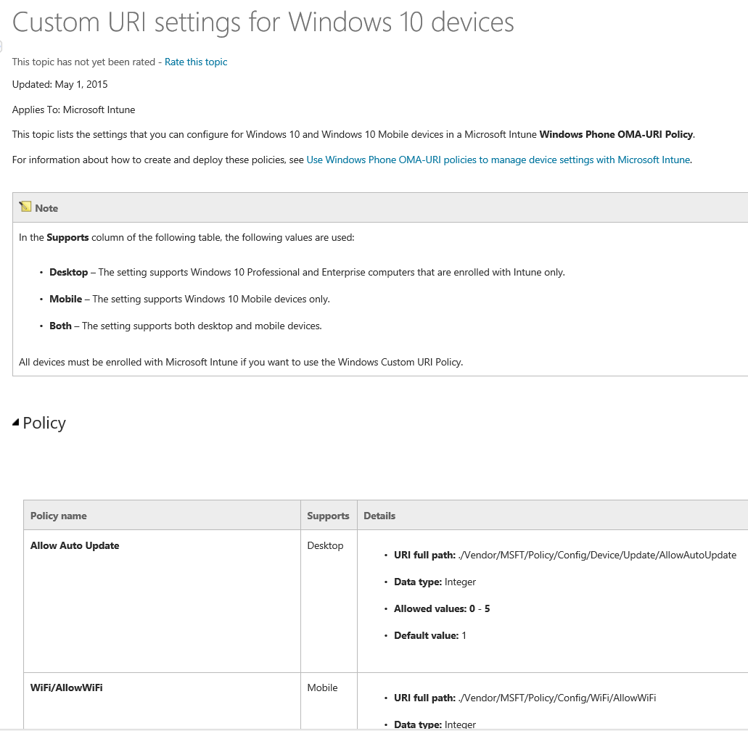
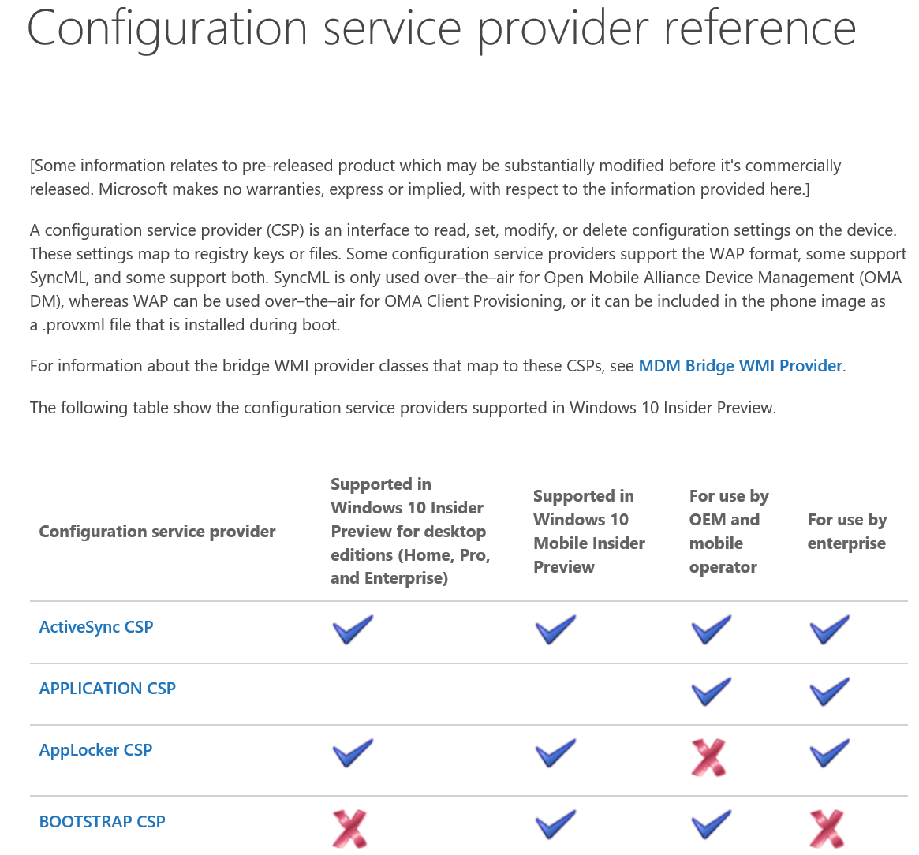
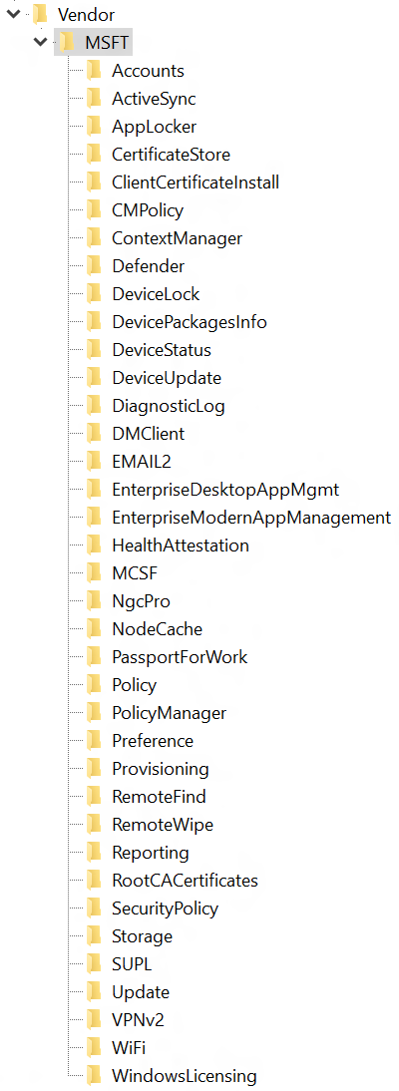
Custom URI settings for Windows 10 devices
References
List of CSP’s: HKLM\SOFTWARE\Microsoft\Provisioning\CSPs\.\Vendor\MSFT
Custom URI settings for Windows 10 devices
Configuration service provider reference

Slide 35
MDM Lifecycle

Slide 36
Mobile Device Management Lifecycle
Un-enrollment with alerts
Removal of configuration
& WIM protected data
Provisioning
Bulk enrollment
Simple bootstrap
Converged protocol
Azure AD Integration
ENROLLMENT
UNENROLLMENT
One consistent set of MDM capabilities across Mobile, Desktop, and IoT
Remote Lock, PIN reset, Ring, Find
Full device wipe
INVENTORY
Enhanced inventory for compliance decisions
Extended set of policies
Context based policies
Client certificates – Direct install (PFX)
Enterprise Wi-Fi profiles
VPN profiles
Email provisioning
MDM Push when user not logged in
Kiosk Mode, Start screen configuration and control
Curated Windows Store
Volume Purchase Program and app distribution
License reclaim/re-use
Enterprise App management
LOB app management
App inventory (MDM/Store)
App allow/deny list
Windows Information Protection
REMOTE ASSISTANCE
DEVICE CONFIGURATION AND SECURITY
APPLICATION MANAGEMENT

Slide 37
Inventory
ENROLLMENT
UNENROLLMENT
Additional device inventory CSP’s being created
Cellular network details (IMEI, ICCID, etc.)
Network identifiers for all interfaces (MAC addresses, IP addresses)
​Password compliance status (desktop)
Current battery level and battery health
Device secure boot status
Configurable custom device ID
Device screen resolution
Device details (OEM, model number, device type, etc.)
INVENTORY
REMOTE ASSISTANCE
DEVICE CONFIGURATION & SECURITY
APPLICATION MANAGEMENT
NOTES
Final inventory settings list to be determined

Slide 38
Device Configuration and Security
ENROLLMENT
UNENROLLMENT
New features to be configured
Windows Hello for Business
Device Update Management
Windows Information Protection
Condition Access / Health Attestation
Enhancements and changes to existing capabilities
Kiosk mode, start screen, start menu layout control
Security policies
VPN management
Enterprise Wi-Fi management
Certificate management
Application Management
INVENTORY
REMOTE ASSISTANCE
DEVICE CONFIGURATION & SECURITY
APPLICATION MANAGEMENT
NOTES
Feature names are not yet finalized

Slide 39
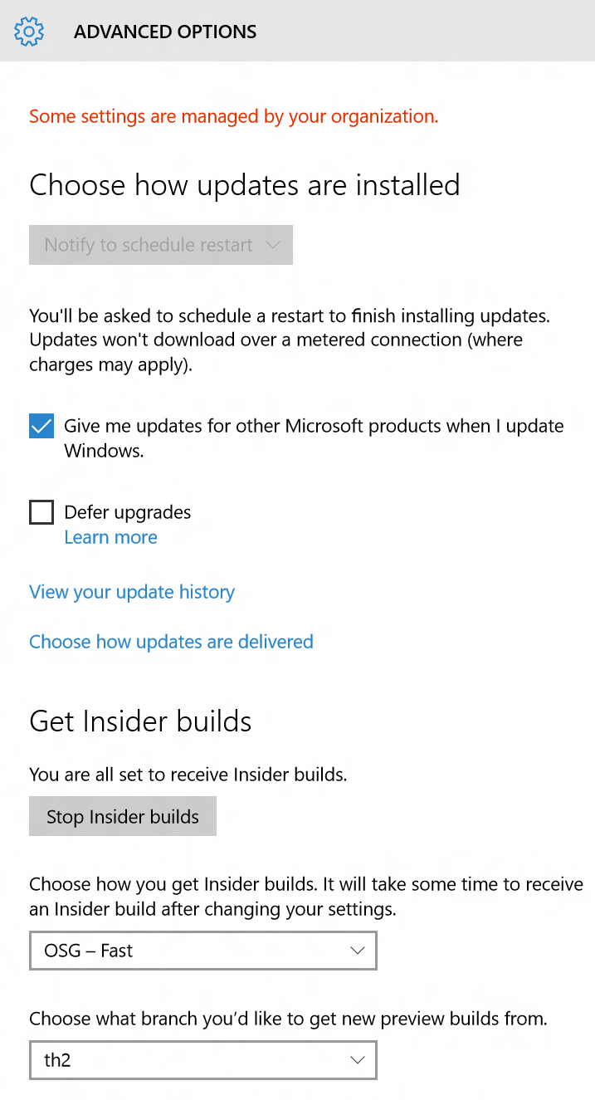
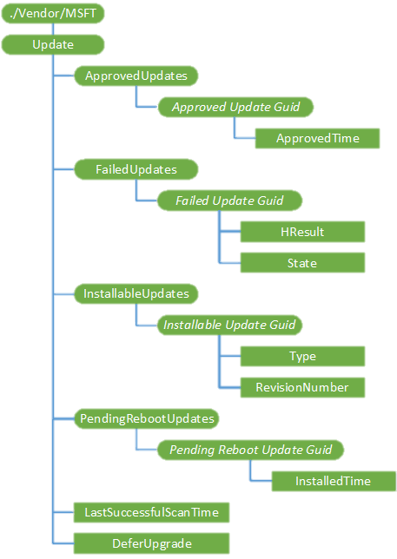
Device Update Management Windows 10 Mobile
ENROLLMENT
UNENROLLMENT
INVENTORY
Windows Mobile
Requires Mobile Enterprise Edition
Provisioning Package
MDM Ent. License Push
“Update” CSP
Same CSP as Desktop Control when & how
Scan & download
Approval for auto install
Defer Updates
App Management
EnterpriseModernAppManagement
REMOTE ASSISTANCE
DEVICE CONFIGURATION & SECURITY
APPLICATION MANAGEMENT
Notes:
Re Upgrade to Mobile Enterprise Edition. There are two ways to accomplish this:
Apply a provisioning package with a mobile enterprise license to the device
Push the mobile enterprise license to the device using a device management solution like Intune
With Windows 10, the device will be continually updated to keep it current. However, for enterprise devices, the admin can now manage these updates through MDM in addition to group policy.
My admin can configure when my device should scan & download updates. For eg. I don’t want to install updates when I open my laptop for my first morning meeting, I would rather prefer to do it at midnight. And if I should be notified before a restart after update install and so on.
With my phone and laptop here that are enrolled, I am sometimes connected to the corporate wifi network and most of the times I am out with just internet access. So the admin can also configure if my device should get updates only from the company’s update server or if it can connect directly to microsoft update and get updates.
We just talked about how the admin wants to decide if the device is compliant before giving it access to company resources. If a device is up to date with the required patches is a critical attribute that most companies require for compliance. For eg. Microsoft IT requires that all security patches be installed in 72 hours from when they are released and if not the device is deemed non compliant to company policy. The information required to make this decision such as which updates are successfully installed vs which ones have failed can be retrieved through MDM.

Slide 40
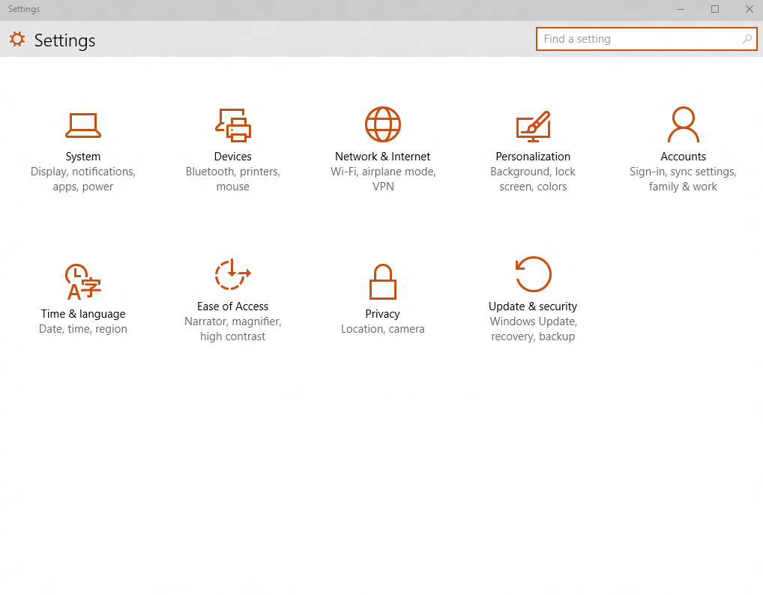
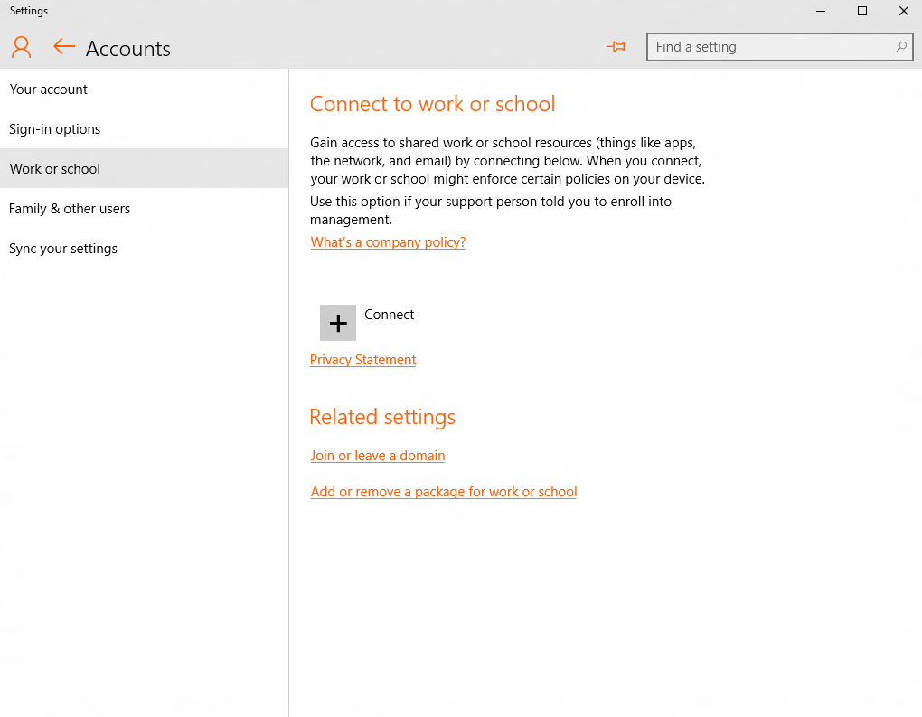
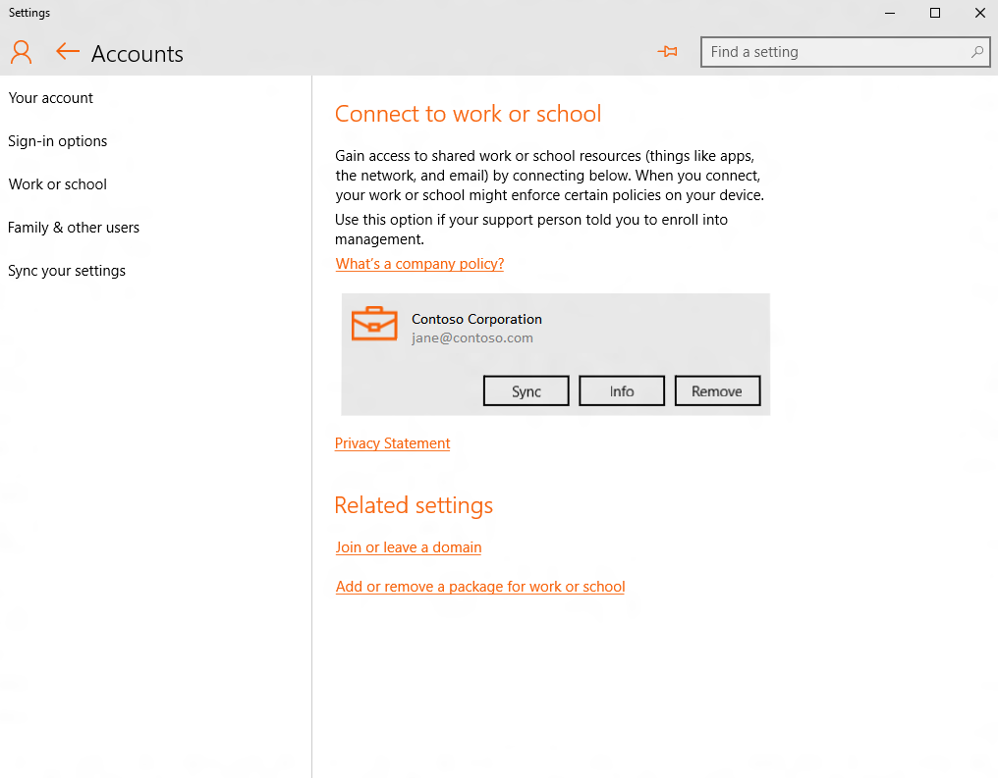
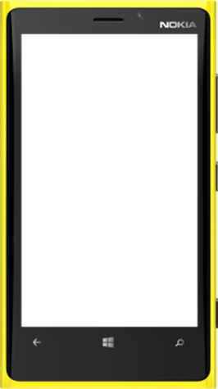
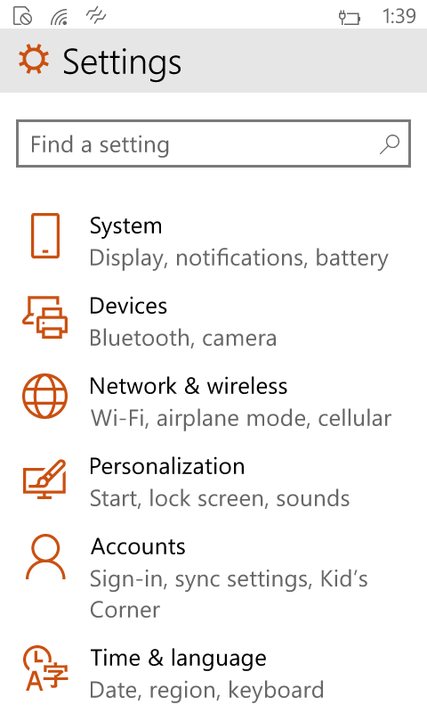
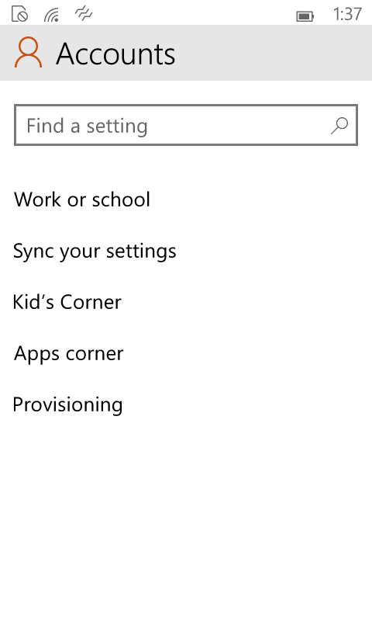
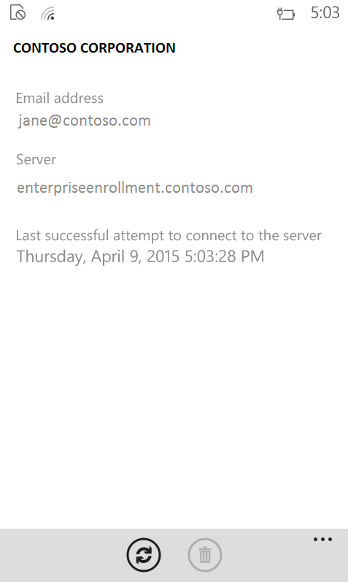

Windows 10 - Enrollment A single experience across all Windows devices
ENROLLMENT
UNENROLLMENT
INVENTORY
REMOTE ASSISTANCE
DEVICE CONFIGURATION & SECURITY
APPLICATION MANAGEMENT
Notes:
So I was able to enroll my phone and my laptop following those.
The benefits of having a single enrollment experience across all windows 10 devices is (1) the user has to learn only one way of doing it and (2) the admin has to publish only one set of instructions.
The other hidden benefit for MDM server vendors is that they have to implement against only one enrollment protocol for Windows 10.
So reminding ourselves of the 4 benefits, we see that consistent user experience is what this provides.

Slide 41
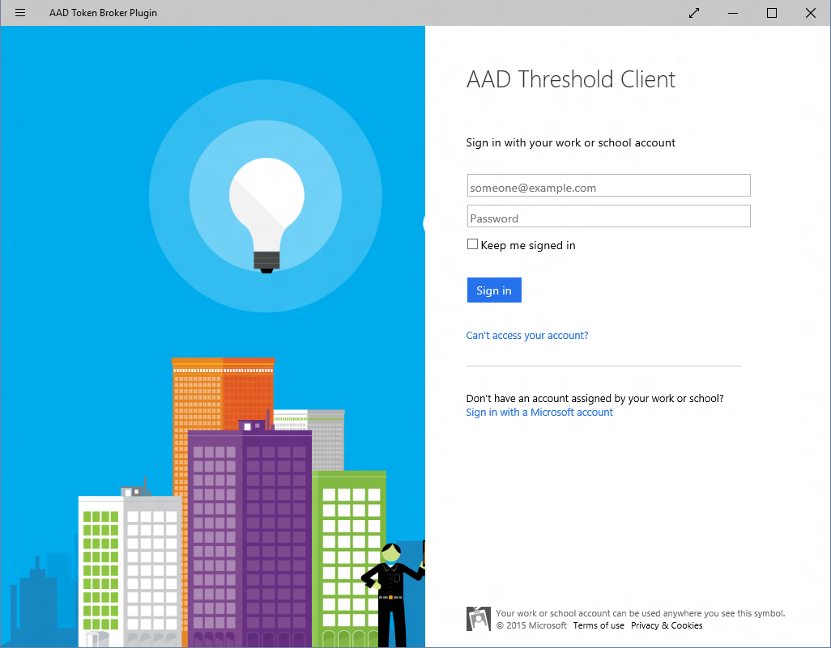
Windows 10 Provisioning and Enrollment Options for all scenario’s
ENROLLMENT
UNENROLLMENT
INVENTORY
REMOTE ASSISTANCE
DEVICE CONFIGURATION & SECURITY
APPLICATION MANAGEMENT
Work or school account
Auto MDM enroll with Azure AD
- Out of Box Experience (first boot)
- Through “Join or leave Azure AD” setting (on existing devices)
Bulk enrollment simplifying IT setup Windows Imaging and Configuration Designer
Removable media SD/USB (Desktop and Mobile)
NFC (Mobile only)
Click on .PPKG file (from email, local storage, media, URL)
USB tether (Mobile only)
Contoso Corp
Sign in to your work or school account
Sign in
|someone@example.com
Allow this PC to be managed ?
Password
Contoso requires this PC to be managed before it can access org resources.
What you get on this PC:
Email, Calendar, Contacts
OneDrive for Business
Access to company apps
How this PC is controlled by Contoso:
Enforce PIN lock
Partial device wipe
Enforce password policy
Monitor device location
Questions? Contact Contoso IT Help Desk at (206) 555-1234.
Forgot your password?
What account should I use?
If your organization uses Office 365 or other business services from Microsoft, use the same user name and password to sign in here.
Privacy statement
Cancel
Sign in
Cancel
Accept
Notes:
I now demonstrated how I just enroll into MDM.
Microsoft can also mandate that I join my Windows 10 device to Azure Active directory since they own the device. Side note – if you are interested to learn more on how Microsoft IT has adopted Azure active directory for identity,
Or if they want me to treat this as my personal device (which gives us the option to test as real users). They give me an options to add an Azure AD account also on this device.
In both these cases, I will automatically be enrolled with MDM. This is great because I do not have to follow two disparate steps to first connect to Azure Active directory and then enroll with MDM.
Some enterprises have a need to distribute devices in bulk to say all employees in the finance group, and ensure that when employees get these devices and power it on, the device is automatically enrolled and the enterprise does not depend on the user enrolling the device. Bulk provisioning and availability of certificate based authentication for enrollment in Windows 10 helps accomplish this.
Do attend the referenced session if you’d like to learn about Bulk provisioning and how it can save you time.

Slide 42
What can be Provisioned (WICD)
Initial Setup
Edition Upgrade
Certificates
Connectivity Profiles
Management Enrollment
Modern
Applications
Win32 Applications
Scripts
Enterprise Policies
Offline content
Browser Settings
Start Menu Customization
Assigned Access

Slide 43
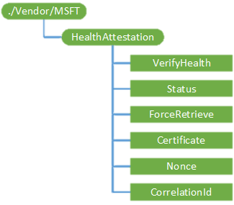
Condition Access / Health Attestation Need access? Prove you’re healthy
ENROLLMENT
UNENROLLMENT
INVENTORY
REMOTE ASSISTANCE
DEVICE CONFIGURATION & SECURITY
APPLICATION MANAGEMENT
MDM evaluates compliance
HealthAttestation CSP Device health attestation
Provable Health
Compliance Rules
Is device patched?
Is Firewall enabled?
Is Antivirus & real time protection enabled?
Company Resources
Documents
Documents
MDM & Windows Attestation Service
Here is my proof
4
Access please
5
1
3
Prove to me you are healthy
You’re in
2
Email
2
Email
Access please
1
Notes:
In the windows 10 timeframe, with Azure AD based conditional access, access to Azure based apps can be controlled based on the device compliance state. The compliance of the device is evaluated by the MDM based on a number of device attributes.
One of these key attributes is the hardware based device health attestation state.
Today we have the ability to detect jailbreak for some of the non windows devices out there. You can think of Device health attestation state for Windows 10 as something like this but provable in hardware.
We have a cloud based Windows health attestation service that is already up and running that Windows 10 devices will talk to, to be certified as healthy.

Slide 44
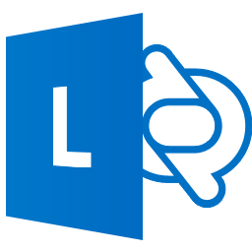








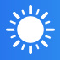

Enterprise Data Protection Company data stays separate & secure
ENROLLMENT
UNENROLLMENT
INVENTORY
REMOTE ASSISTANCE
DEVICE CONFIGURATION & SECURITY
“Enterprise data protection”
User friendly work-personal separation
Manage what data is “Enterprise”
Audit intentional data disclosure
Azure RMS
VPN integration
APPLICATION MANAGEMENT
Data exchange is blocked or audited
Business Apps & Data
Managed
Personal Apps & Data
Unmanaged
for business
personal
Notes:
Here are more details: We support two forms of key management for EDP.
Local keys: In case RMS is not configured, data is protected using a key that is local to the device. Files are protected on the device with this key and can still remain protected when copied to USB. However, the files will not be accessible on any other device because the key is tied to the device.
RMS: With RMS being configured, protected files can roam and be shared. This allows files to be accessible on other devices such as iOS/Android etc.
If an organization doesn’t have RMS deployed but is interested in protected roaming/sharing scenarios, we will provide an option to sign up for Azure RMS when configuring EDP.

Slide 45
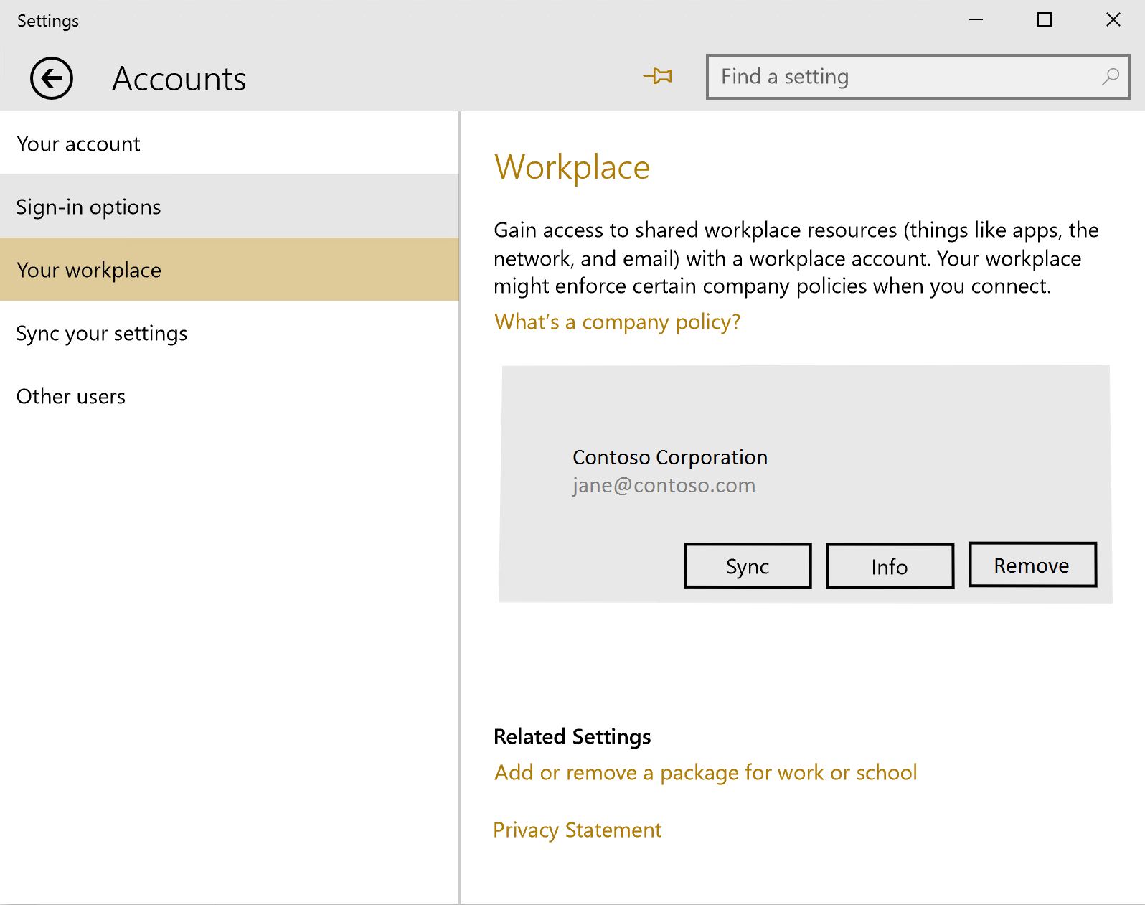
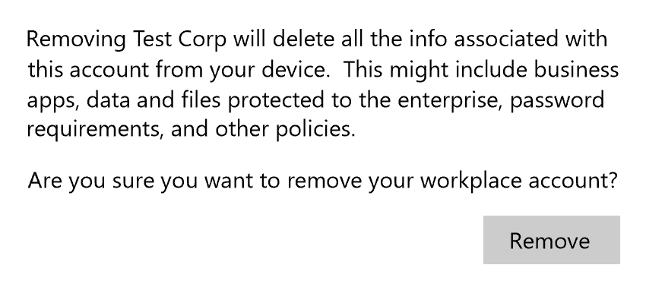
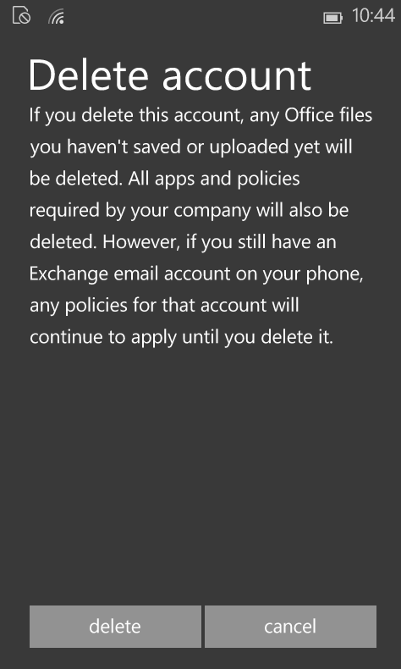
Un-enrollment Remove all Enterprise Data
ENROLLMENT
UNENROLLMENT
INVENTORY
REMOTE ASSISTANCE
DEVICE CONFIGURATION & SECURITY
APPLICATION MANAGEMENT
Smarter asset removal
Certs, VPN, Wifi, Email profiles, policies
Applications & App data
Windows Information Protection data
Either admins or users can un-enroll
Server notified on user un-enroll
Admins control if users can un-enroll
Consistent experience
Azure AD Unjoin triggers un-enroll
Notes:
Unenrolling the device from MDM removes all configuration that the admin pushed to my device such as the certificates, PIN policies, Wifi and VPN connections etc. The data that is configured to be “enterprise data” and under enterprise data protection is also completely removed.
<click> The admin can configure a policy that prevents me from unenrolling in which case the admin controls when and if I can unenroll, and can remotely trigger the unenroll.
For personal devices, companies usually allow the user to choose when they want to unenroll and in this case, when I unenroll, the server is notified about it.
<click> And looking back at our 4 benefits, the experience for the user is consistent.
And so these are some of the new features we have in Windows 10 MDM that you can use

Slide 46

Management with SCCM

Slide 47
Management options – Windows 10
IDENTITY
Active Directory
Azure Active Directory
MEMBERSHIP
Domain join | Workgroup
Azure AD join
MANAGEMENT
Group policy
New GPOs | AGPM scripting
ConfigMgr
MDM policies via WMI bridge
MDM
New configuration | Initial provisioning
Exchange Active Sync
Powershell | WMI
Notes:
Let’s explore the management capabilities that Windows 10 brings forward from earlier versions of Windows and the new capabilities that we can leverage in management of mobile devices, BYOD devices and corporate-owned systems.
Identity: Existing – AD, New – Azure AD
Membership: Existing – Domain Join or workplace join, New – Azure AD Join
Management: Existing – Group Policy, SCCM Agent, MDM (Agent), EAS, WMI/PowerShell. New – New GPOs, SCCM management via WMI Bridge, New MDM policy capabilities.

Slide 48
Windows 10 Management Architecture
MDM (Intune)
Provisioning
EAS
ConfigMgr
Service/Server
Device/OS
MDM Client
Provisioning Engine
EAS Client
WMI Bridge
Common Device Configurator
WMI providers
MDM Configuration Service Providers (CSP’s)
Common component
PC component
Notes:
With the consolidation of the Windows code base, Windows 10 needed to be able top support management through Mobile Device Management tools, through current desktop client management methods, and to be compatible with future management tools. In order to accommodate this, we adopted the Open Management Architecture or OMA, specifically OMA-DM, which defines device management processes.
Looking a bit under the hood, the Management stack is designed in such a way that whatever management tool you use in your Enterprise to set policies - for eg. Microsoft IT sets policies through MDM and also Exchange Active Sync – they all go through the same management layer <click> thus making automatic configuration resolution possible by the device.
Device configurations, such as files and registry settings, and the configuration of those settings are primarily managed by Configuration Service Providers (CSPs). These modules take their orders from the Common Device Configurator, a flexible management layer that can interface with a variety of management tools. The various m,anagmeent clients, ride on top of the Common Device Configurator and expose standards-based management sockets to their respective tools.
The MDM client operates as an OMA-DM mailbox, able to take OMA-URI-formatted messages from Intune or third-party MDM systems that use the OMA-DM standard.
The Provisioning Engine, reads Provisioning Packages and process the contents to configure the system through the new “Provisioning Process”.
EAS Client accepts settings and control messages from the Exchange Active Sync service.
The WMI Bridge is designed to expose expected WMI capability that System Center Configuration Manager Agent expects when managing system configuration. System Center configuration manager is a popular tool and is widely used by many Enterprises including our own IT.

Slide 49
You have more policies for granular control
Security
Connectivity
Experience
Microsoft Passport PIN policies
Firewall & Defender
Block sharing internet via Wifi
Auto connect VPN
Cortana
Theme background & color
Hardware
System
Email
Camera policies
Bluetooth
Sync settings
Telemetry & flighting
Exchange Active Sync policies
Email profiles configuration
This is only a sample list…there are over 100 new policies!
Notes:
Let’s explore some examples of policies that you can use to configure and manage Windows 10 devices.

Slide 50
Group Policy
New Policies in Windows 10
Start screen and start menu management
Microsoft Edge settings
Next-Generation Credential PIN settings
Universal app management
New Policies From Windows 7
New capabilities released in Windows 8.1
Policy caching
IPv6 support for printers, VPN, targeting
New capabilities released in Windows 8
Sign-in optimization for DirectAccess clients
Better use of larger registry policies (registry.pol)
Remote group policy refresh (GPUpdate)
More efficient background processing
Security Baselines
Microsoft will continue to work with relevant parties to expedite the release of Windows 10 Security Baselines.
Notes:
New Policies in Windows 10
For those using Active Directory and Group Policy to manage organization-owned devices, we will of course provide new policies to support Windows 10 features like the new Microsoft Edge browser, Next-Generation Credentials, Start screen and start menu controls, and more. We want to ensure that it’s easy for you to drop new Windows 10 devices into your infrastructure and manage them like you do today.
New Policies from Windows 7
Since many of you are still using Windows 7, it’s important to also point out the Group Policy investments that we made in Windows 8 and Windows 8.1. Many of these changes were to improve the overall performance of Group Policy, especially when devices are connected across slow network links or DirectAccess. We also improved support for larger policies and added support for other new capabilities added in those releases, such as with IPv6 and VPN.

Slide 51
Prepare
Licensing
Patch KMS servers to provide Windows 10 licenses to corporate devices
Group Policy
Windows 10 group policy management templates to be added to a server / central policy store
Review new Windows 10 group policies for inclusion - Use Windows 8.1 security baselines as starting point
Windows Update
Plan to patch Windows Server Update Services (WSUS) to support Windows 10 updates.
System Center
Patch System Center Configuration Manager 2007 to enable management of Windows 10
Patch System Center 2012 (R2) Configuration Manager to enable management and deployment of Windows 10.
Microsoft Desktop Optimization Pack
Statement of support or updates available for Windows 10 available at RTM for:
Microsoft Application Virtualization (App-V)
User Experience Virtualization (UE-V)
Microsoft Bitlocker Administration & Monitoring (MBAM)
Diagnostic & Recovery Toolkit (DaRT)
Advanced Group Policy Management (AGPM)
Notes:
Positioning
Updates will be required to the existing infrastructure to accommodate Windows 10 in the environment.
Updates available at RTM to enable rapid adoption of Windows 10

Slide 52

Servicing Windows 10
Notes:
There is some confusion around how to manage Windows as a Service (WaaS). While we explore this in depth in the WaaS session, lets take a look at how this applies to SCCM in particular.

Slide 53
Windows-as-a-Service shifts periodic deployment to ongoing upgrade management
Traditional Deployment (every 3-5 years)
Vista
Windows 7
Windows 8.1
Windows as a Service (twice per year)
Windows 10
Deployment is much easier, but customers still value partner support
Package as an ongoing partner managed desktop offering with support and other services
Drives recurring revenue stream, higher margins, lower cost of sales, and lower churn
Add on security support offerings leveraging Windows Defender ATP
Notes:
It’s probably fairly obvious that the traditional Windows deployment project, which organizations would typically do every 3-5 years, needs to change. These changes are need to reduce the overall effort to something that can reasonably be performed twice per year.
Let’s drill into the differences between old and new to understand how to do this.

Slide 54
Comparing Windows 10 servicing branch choices
 | Current Branch | Current Branch for Business | Long Term Servicing Branch
Primary purpose | Pilot Deployments | Broad Deployment | Special Devices
Deployment timeline | Soon after release | ~ 4 months (or more) after release | Any time during lifecycle
Release frequency | 6 months (approx.) |  | 2-3 years (approx.)
Updates | All security fixes, moderate bar for other fixes |  | All security fixes, high bar for other fixes
Apps | All in-box apps |  | No in-box apps (except system apps)
Browser | Edge and Internet Explorer 11 |  | Internet Explorer 11
Windows features | All |  | Excludes Cortana, Windows Store
Notes:
When we talk about Windows as a service, we typically talk about three different servicing options. Two of these, Current Branch and Current Branch for Business are very similar – not surprising, because they are the same Windows 10 release, just at different points in time: Each release is initially considered a Current Branch release, and then after about four months it’s declared a Current Branch for Business release, signaling that it is ready for broad deployment.
Contrast that with the Long Term Servicing Branch, which is distinctly different – it has a 10-year lifecycle with no new features, with ongoing updates that focus primarily on security fixes. It has no built-in apps, and fewer Windows features – for example, it doesn’t include Edge, Cortana and the Windows Store, because those features are frequently updated with new capabilities driven by app and service updates.
You shouldn’t think of devices as being “Current Branch” or “Current Branch for Business”. Instead, devices can be running a Windows 10 release that is currently considered Current Branch, but that release will eventually become a Current Branch for Business release, with no action needed on the device to achieve that transition – it’s just a changed declaration.

Slide 55
Windows as a service – worldwide deployment waves
Windows 10 Development/Deployment Rings
Deployment of Windows 10 Releases Over Time
Broad Deployment Ring III
Specific feature and performance feedback
Application compatibility validation
Deploy to pilot audiences
Validate and prepare for broad deployment
100 M
Broad Deployment Ring II
Deploy to all audiences, in waves to reduce risk
Broad Deployment Ring I
Pilot Ring Early Adopters
Broad Deployment
Evaluate
Pilot
(CB)
Deploy/Use (CBB)
Grace
10 M
60 days
6+ months of active development
~4 months
12+ months
Worldwide Users
Pilot Ring
QA
Pilot
16+ months to validate, deploy, and use each release
Pilot Ring IT
1 M
Microsoft
Insider Preview Branch
The process repeats…
Evaluate
Pilot
(CB)
Deploy/Use (CBB)
100 K
Broad Microsoft Internal Validation
1,000
Evaluate
Pilot
(CB)
Deploy/Use
(CBB)
Engineering
Builds
Windows Insider Preview Branch
1
6 Months
16+ Months
New Windows 10 Releases
Only 2 CBB versions in active support at one time
*Conceptual illustration only
Time
Notes:
Looking at the entire timeline, from the earliest engineering builds through the final devices in an enterprise-wide deployment, you can see that we’re talking about a process that spans almost two years: Six months of active development, followed by about four months of pilot deployments, before starting broad deployment throughout the entire organization – and of course, then using this particular Windows 10 feature update until it’s time to repeat the process.
Notice the “rings” defined in this picture: This is our recommended way of performing the deployment of each Windows 10 feature update, with each ring representing a group of PCs. First using a small number of pilot groups to ensure everything works as expected, then a number of broad deployment rings (primarily to reduce risk, e.g. don’t deploy the whole Accounting department at once).

Slide 56
Customer/partner deployment by “rings”
20,000
Initial Windows 10 Deployment
Later Windows 10 Updates
Broad Deployment Ring IV
10,000
Broad Deployment Ring III
Special purpose dedicated devices Security patched but not updated
Full Customer Deployment
LTSB
LTSB
5,000
Broad Deployment Ring II
Wave 3 Deployment
Wave 3 Deployment CBB
Broad Deployment Ring I
500
Broad Deployment
Divide up broad population balanced for risk reduction, business impact, network load, functional role, application use, and geography
Pilot Ring Early Adopters
Wave 2 Deployment
Wave 2 Deployment CBB
Pilot Ring
QA
Pilot
Partner/Customer Validation
Pilot Ring IT
Wave 1 Deployment CBB
Wave 1 Deployment
More PCs, Apps
10
Small Group of PCs
POC
Pilot
Representative Sample of Volunteer Users
Pilot CB
Testing
POC
Insider Preview
1 Month
2 Months
3 Months
Time
IT Test Devices
Notes:
The initial Windows 10 Deployment will start with a Proof of Concept. From there, you will move through the Pilot deployment and on to incremental “wave” deployments through-out the customer’s organization. Similarly, each time a new Windows 10 update comes out (every 6 months), you will want to help customers to deploy the updated Windows 10 operating system. The POC will be done using Insider Preview bits. Once the full update is released, you will move your customer through the Pilot and “wave” deployments of the updated Windows 10 operating system – just as before. This is an on-going service that you can provide to your customers, with the additional opportunity to address service, application, and infrastructure needs along the way. Windows-as-a-Service will become an integral part of your business relationship with the customer, one that opens up numerous new project and service revenue opportunities!

Slide 57
Thinking through deployment strategy
1
Configure Your Insider Preview PCs
Lab or secondary PCs
Enough to explore new features, measure compatibility on behalf of your customer(s)
2
Recruit volunteers for pilots
Willing participants who will provide feedback
Cover the broadest set of apps and devices possible
3
Identify LTSB PC candidates
Deploy Windows 10 Enterprise LTSB
Limited numbers (we hope)
4
Divide broad population of PCs for roll-out
Standard deployment best practice
Focus on risk reduction, minimizing disruption
Consider deploying waves by functional area, applications utilized, and geography
Notes:
Thinking about this from a deployment strategy perspective, there are a few steps that we need to consider:
What PCs will we use for the Insider Preview program? Each organization needs to try out new features and at the same time ensure that strong compatibility is maintained, providing feedback with any concerns.
Can we identify the special PCs that would be good candidates for LTSB? (Remember again that special PCs typically don’t run Office – they run other specialized software suited for their unique purpose.) Those will be deployed separately, so they can be set aside.
Can we recruit the appropriate set of volunteers for pilot deployments? Remember, we want to identify a small group of PCs that covers the broadest set of apps and devices – 10% of devices should be able to provide 90% coverage. And we want to ensure that these pilot participants are volunteers – if they find issues, we want them to call the IT helpdesk; we don’t want them to immediately escalate up their management chains if something doesn’t go quite right.
Finally, can we divide up the broad population of PCs into a reasonable number of groups, so that we can deploy quickly and still manage risk appropriately.

Slide 58
Why Windows-as-a-Service updates run better
Windows 7 and 8 Servicing
What Microsoft Tests
Windows Test Lab PC: Fully Patched
Windows 10 Servicing
Security Updates
Most organizations deploy right away
Limited Partner/Customer pre-trial
Non-Security Updates
Reliability, bug fixes, etc.
Deployed ad-hoc or sometimes not at all
The option to take each service upgrade or not (selective patching) in Windows 7 and 8, increased fragmentation, added complexity and cost, and reduced quality
Version Upgrades
New features, new UI, new architecture
Deployed years apart with customers running non-current versions
Quality Updates
A single cumulative update each month, which supersedes the previous month’s update
Security fixes, reliability fixes, bug fixes, etc. but no new features
Partner/customer pre-trial with Security Update Validation Program (SUVP)
Feature Updates
Targeting twice per year with new capabilities
Very reliable, with built-in rollback capabilities
Simple deployment using in-place upgrade, driven by existing tools
Partner/customer pre-trial with Insider Preview
What Customers Are Running
Typical Windows 7 PC: Selectively Patched
Windows 10 PC:
Cumulative Update
With Windows 10 servicing, consistency and simplicity are paramount
Notes:
When we talk about changes to the way we service (or patch) Windows, it’s important to first understand how things worked with Windows 7 and Windows 8.1. Each month, we release somewhere between 1 and 20 individual fixes for each one – some security updates, some non-security updates. Most organizations deploy the security fixes right away. But the non-security fixes sometimes aren’t deployed at all. The result is that each organization ends up with their own unique Windows configuration, defined by the set of patches that they have installed.
Compare that to the configuration that we test: Fully-patched PCs that have all the updates ever released installed. For each new update, we verify that there are no adverse effects on these fully-patched PCs.
But we’ve seen instances where these new updates cause issues on partially updated PCs (often with specific combinations of updates) – we can’t possibly test all these different possible combinations. And affected customers wonder why we didn’t catch these “simple issues” when we did our testing.
So we decided that to improve the overall quality of Windows, and to reduce the overall complexity of the patching process, we would rework the patching process altogether with Windows 10. Let’s explore these changes in more depth.
First, it’s important to understand that we have two different types of updates with Windows 10: Quality updates, released each month with no new features to resolve security and non-security fixes, and feature updates, targeting twice per year with new features added.
For quality updates, each month we will release a single update, containing all the new security and non-security fixes (but with no new features), as well as all the existing fixes from previous months. As a result, there is only ever one update that needs to be installed on a Windows 10 device for it to be completely up-to-date.
We are considering making changes to the Windows 7 and Windows 8.1 monthly update process, to bring some of these same benefits to older OSes too. Stay tuned for more information on this.

Slide 59
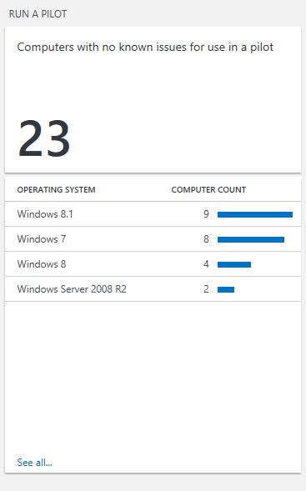
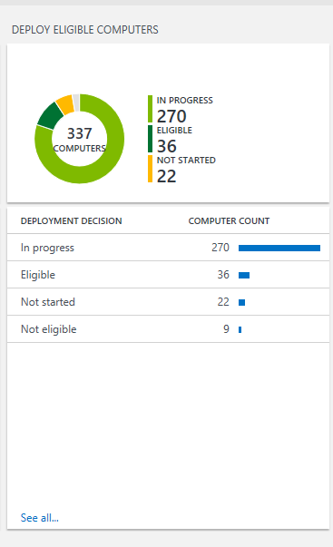
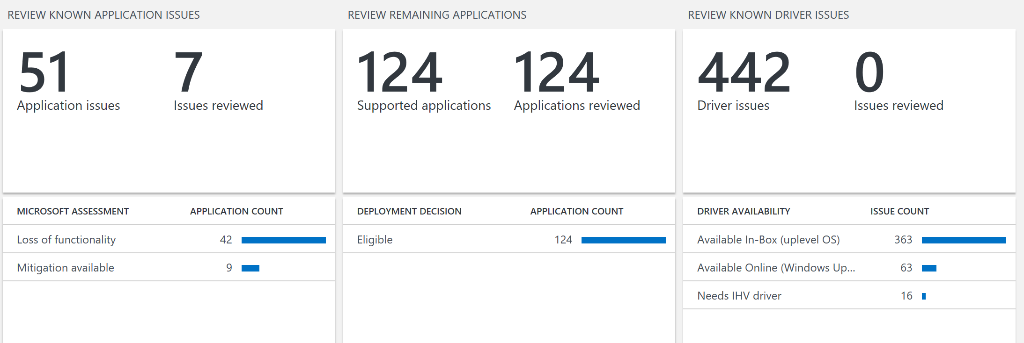
New Upgrade Analytics Service supports your management of Windows 10 and future upgrades
Free service from Microsoft
Deployment dashboard
“Devices Ready to Deploy” Reports
Inventory reports: devices, drivers and applications
Device level app usage information
App and driver report – known issues to Microsoft
Deployment validation tool
Data export into management tools (e.g. SCCM)
Upgrade Analytics Service for Windows 10
Notes:
360 degree view into the organization device, driver and application inventory keeps you in control
Clear workflow visualization from pilot to deployment reduces complexity and risk
Data driven app rationalization tools reduce validation time and cost
Direct access to guidance and insights into compatibility issues known to Microsoft gives you help when you need it

Slide 60
Customers can use different deployment tools today, so it’s important to consider customer infrastructure…
Identify the best tool for deployment
Windows Update for Business
Windows Server Update Services
System Center Configuration Manager
Cloud
Upgrades can be deferred
Builds on top of Windows Update
Uses Windows Update for content
On-Prem
Upgrades are deployed when you approve them
Content distributed from WSUS servers
Requires KB3095113
BranchCache to reduce bandwidth
On-Prem
Choice of task sequence-based upgrades or (with vNext) software update capabilities
Content distributed from ConfigMgr DPs
BranchCache to reduce bandwidth
Notes:
We have a variety of tools that can be used by organizations to implement Windows as service. Fortunately, most organizations are already using one of these tools, so as long as you are using a reasonably current version of them, you’re already got what you need.
The simplest possible tool to use is Windows Update: just point all PCs to the Windows Update cloud service and let them update themselves as new feature updates are released. Most organizations probably want more control over that process, and we’ve provided those controls as part of Windows Update for Business, an additional layer of control that sits on top of the Windows Update service to provide more advanced capabilities.
For organizations already using WSUS or ConfigMgr, both have built-in capabilities for managing feature updates.
Most organizations probably aren’t interested in Windows Update directly, so let’s look at the other three choices in more detail.

